Slide 1


Elastically scale .NET caching for real-time processing
Fawaz Ghali – Developer Advocate
@fawazghali

Slide 2

Scan QR Code to Win $100 Gift Voucher

Slide 3

About me
Fawaz Ghali
Developer Advocate at Hazelcast
Liverpool, UK
+20 years of experience in the industry, research and academia
PhD in Computer Science
Sub 3 marathoner

Slide 4
What is real-time?
Nanoseconds: A nanosecond (ns) is one billionth of a second.
Microseconds: A microsecond (µs) is one-millionth of a second.
Milliseconds: A millisecond (ms) is one one-thousandth of a second.
Examples:
The camera flash illuminates for 1,000 microseconds, or 1 milliseconds.
Camera shutter speed for 4,000 microseconds or 4 milliseconds.
Avg. human eye blink takes 350 milliseconds (just over 1⁄3 second).
Avg human finger snap takes 150 milliseconds (just over 1⁄7 second).
Hazelcast use-cases: microseconds to milliseconds, milliseconds to seconds

Slide 5

Real-time is everywhere!
While the customer is banking
When the customer is shopping
During a fraudulent event
Before a process breaks
When a patient needs attention
Value
Real-Time
Batch
2010 2020 2030

Slide 6

Caching vs Stream Processing
Fast Data Stores
Stream Processing Engines
In-Memory Stores
ksqlDB
Kafka Streams
Redis
Aerospike
Spark Streaming
VoltDB
MongoDB
HANA
Couchbase
Flink
Cassandra
Kinesis Streams
SingleStore

Slide 7













Hazelcast Architecture
End User Applications
Microservice Servlet
Microservice Servlet
Microservice Servlet
Microservice Servlet
Microservice Servlet
Microservice Servlet
Analytics
Client
Java Client
C#/.Net Client
C++ Client
JS Client
Python Client
Go Client
JDBC
SQL
SQL
SQL
SQL
SQL
Nearcache
Nearcache
Nearcache
Nearcache
Nearcache
Kafka
The Hazelcast Platform
Kafka
MQ
MQ
Stream and Batch Processing Engine
Compute
IoT
Continuous
Business Events
Pipeline
Alerts
Custom Connector
Interactive Analytics
Enterprise Applications
Transform
Combine
Stream
ML Inference
Enterprise Applications
Hazelcast
In-Memory Data Store
Storage
Actionable
Context
Hazelcast
File Watcher
Databases
Socket
HDFS, S3, NoSQL
Persistence
Database Events
Files
Sources
Sinks
Systems of Record
Notes:
Looking at this diagram - streams horizontal and end user requests vertical.
Constitutes a kappa architecture. Streaming and in-memory processing
Streams - left to right
Continuous flow of data from machines, enterprise apps, smart sensors, IOT for example.
Enables you to respond to data quickly, analyse, identify insights or patterns of data
Push to another recipient/destination/sink
This is about very fast data access and processing - all in memory - then providing the output/answer

Slide 8

Deployment Architecture vs Traditional
Or YARN
Master Node
Application
Self-contained
application (control, backups, caching, resilience, …)
Alt Driver
Alt Master
Zookeeper
Zookeeper
Streaming Jobs
Zookeeper
Hazelcast
Worker Node
Worker Node
Worker Node
Application
Application
Executor
Executor
Executor
Streaming Jobs
Streaming Jobs
Hazelcast
Hazelcast
HDFS
HDFS
HDFS
Simplified Deployment
Lightweight footprint, ideal for edge use cases
In-memory performance – ultra-fast stream processing with integrated data layer
HDFS NameNode(s)
HDFS NameNode(s)
HDFS NameNode(s)
Complex infrastructure to install/maintain
Many components, requires large hardware footprint
Not optimized for streaming performance
Notes:
HIGHLIGHT FAULT TOLERANCE

Slide 9
Features
Use the Hazelcast Near Cache feature to store frequently read data in your .NET process. This provides faster read speeds than traditional caches such as Redis or Memcached. Eventual Consistency is also supported.
Access all of the Hazelcast data structures plus distributed queues, topics, and more with the Hazelcast .NET Client.
Provides SSL support and Mutual Authentication for your enterprise-level security needs.
Support JSON or serialized objects.

Slide 10
Comparison
Databases
Data Grids
Stream Processing Engines
Storage-only
No distributed compute
Heavyweight, not ideal for the edge
No stream processing
Not cloud-native
Designed for specific environments
No stream processing
Too slow to handle on-demand batch jobs
Heavyweight, not ideal for edge
No native machine learning inference support for other programming languages
In-Memory Computing Platform
Integrated in-memory storage, distributed compute, stream processing
Embeddable, lightweight, configurable for either cloud or edge
Cloud-native (elastic, Kubernetes-ready, multi-cloud enabled)
Extremely fast, batch processing workloads in near-real-time speeds
Notes:
Hazelcast is:
One-stop-shop for storage, compute, messaging and stream processing
Tiny footprint and highly portable from edge to cloud
Dynamic orchestration/elastic via Kubernetes/Openshift – multicloud ready
High performance ML inference for Java/Python/C++

Slide 11
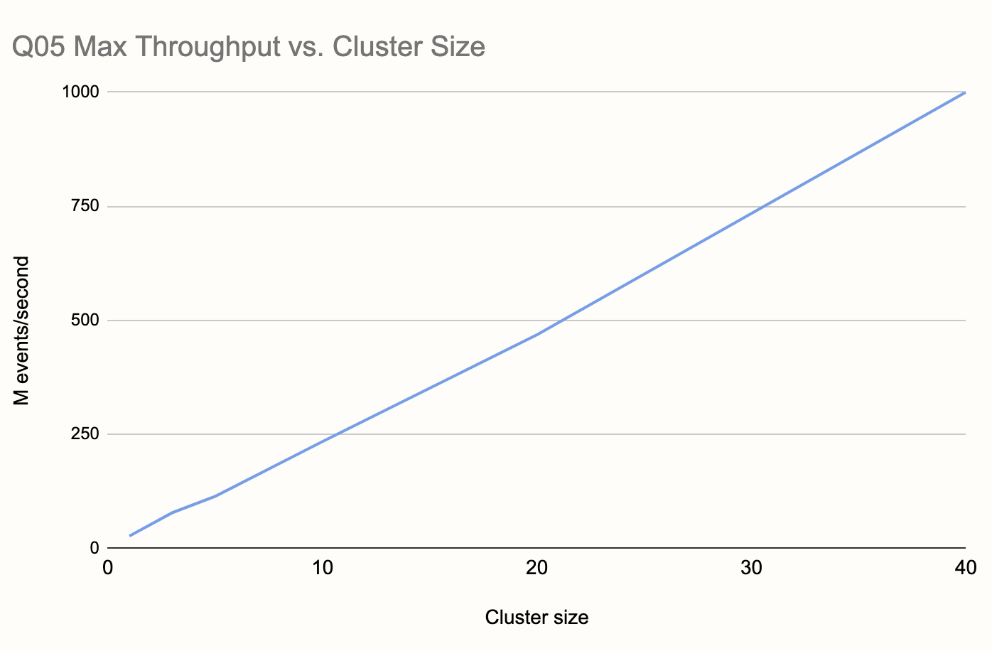
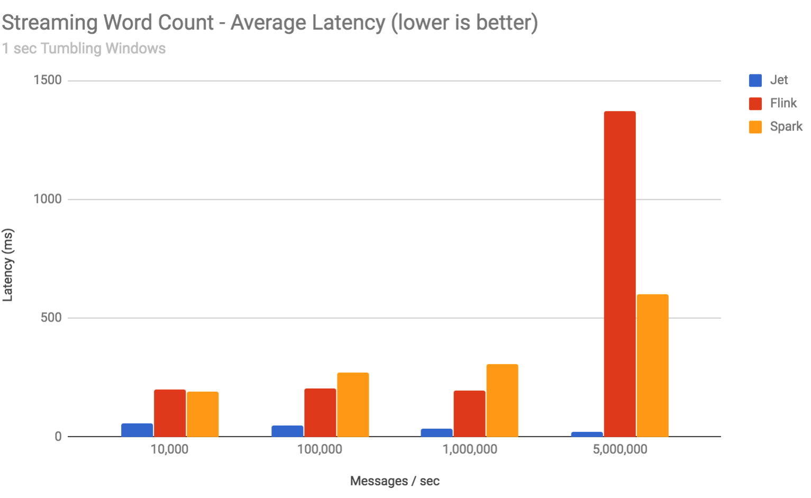
Gigascale Real-time Data Processing
1 BILLION TPS with 99% under 30ms latency
45 nodes
Linear scaling with predictable latency

Slide 12


Architecture – Scale Ingest/Data/Compute
Data Processing
Streaming Ingest
Live Events
Queries, Logic &
Machine Learning
Event Stream Input
Analytics
Source
Queries, Logic &
Machine Learning
Streaming Ingest
Live Events
Analytics
Source
Queries, Logic &
Machine Learning
Streaming Ingest
Live Events
Analytics
Sink or Client App
Source
Queries, Logic &
Machine Learning
Streaming Ingest
Live Events
Analytics
MLOps Runtimes
Linear Scaling
Peer-to-Peer Architecture
Notes:
One way you can use Hazelcast IMDG and Jet together is by having them scale together, where one Jet instances feeds into one IMDG instance,
This works well for smaller environments where simplicity is most important than scaling flexibility.

Slide 13
Deployment Choices
Remote Deployment
stream processing cluster
Local Deployment
Message Broker (Kafka)
Combined in-memory store and stream processing cluster
Data Enrichment
Source /
Enrichment
Sink
Enrichment
in-memory store cluster
Sink
Good when:
You desire simpler, integrated deployments
You need the absolute lowest latency
in-memory store and stream processor have equivalent sizing needs
Good when:
Data-at-rest needs to access the in-memory store RAM pool
You want to independently scale compute and storage
Notes:
Jet is build on top of Hazelcast with the benefits of close integration. Hazelcast Jet and can run in these deployments:
Every Jet cluster works on top of embedded Hazelcast in-memory data grid. Embedded deployment suits well for:
Sharing processing state among Jet nodes
Caching intermediate processing results
Enriching processed events. Cache remote data (e.g. fact tables from database) on Jet nodes.
Running advanced data processing tasks on top of Hazelcast data structures
Development purposes. Since starting standalone Jet cluster is simple and fast.
Remote deployment
Share state or intermediate results among more Jet jobs
Cache intermediate results (e.g. to show real-time processing stats on dashboard)
Load input or store results of Jet computation in in-memory fashion to
Isolation of processing and storage layer
Jet x – product differentiation
Both Jet and are for parallel and distributed computing, why Jet is more expensive? Is Hazelcast IMDG not good enough?

Slide 14


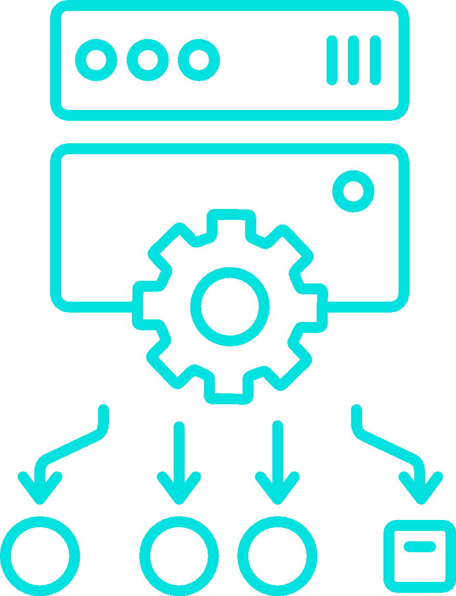


Hazelcast Cloud Use Case: Caching Layer for Cloud-based Microservices
Hazelcast Cloud: Distributed Caching Layer for Microservices
API Layer
Application Layer
Operational Store/Cache
Java App
Users
Amazon API Gateway
C# App
Load Balancer
.NET App

Slide 15
Caching
 | Hazelcast Enterprise | AWS Elasticache – Redis | GCP MemoryStore – Redis | Azure Redis
Ability to handle large data sizes | 100s of gigabytes to terabytes. Off-heap storage avoids garbage collection overhead. | At most 5 read-only shards per master shard. | Scale up only; no scale out. | Up to 53GB per shard; 10 shards maximum

Slide 16
Demo: 1- Queue / DistributedObjects 2- SQL Over Kafka

Slide 17
Quick Start + Download
From NuGet package manager console: Install-Package Hazelcast.Net
Start Hazelcast
CLI
Local Docker
Cloud
Open Terminal
mkdir queue
cd queue
dotnet new console
dotnet add package Hazelcast.Net
dotnet add package Microsoft.Extensions.Logging.Console
dotnet build

Slide 18
Start Hazelcast
dotnet run --hazelcast.networking.addresses.0=127.0.0.1:5701 --hazelcast.networking.smartRouting=false --hazelcast.clustername=dotnet-stock-demo
docker run \ 
-it \
--network hazelcast-network \
--rm \
-e HZ_CLUSTERNAME=dotnet-stock-demo \
-p 5701:5701 hazelcast/hazelcast:5.1.2

Slide 19
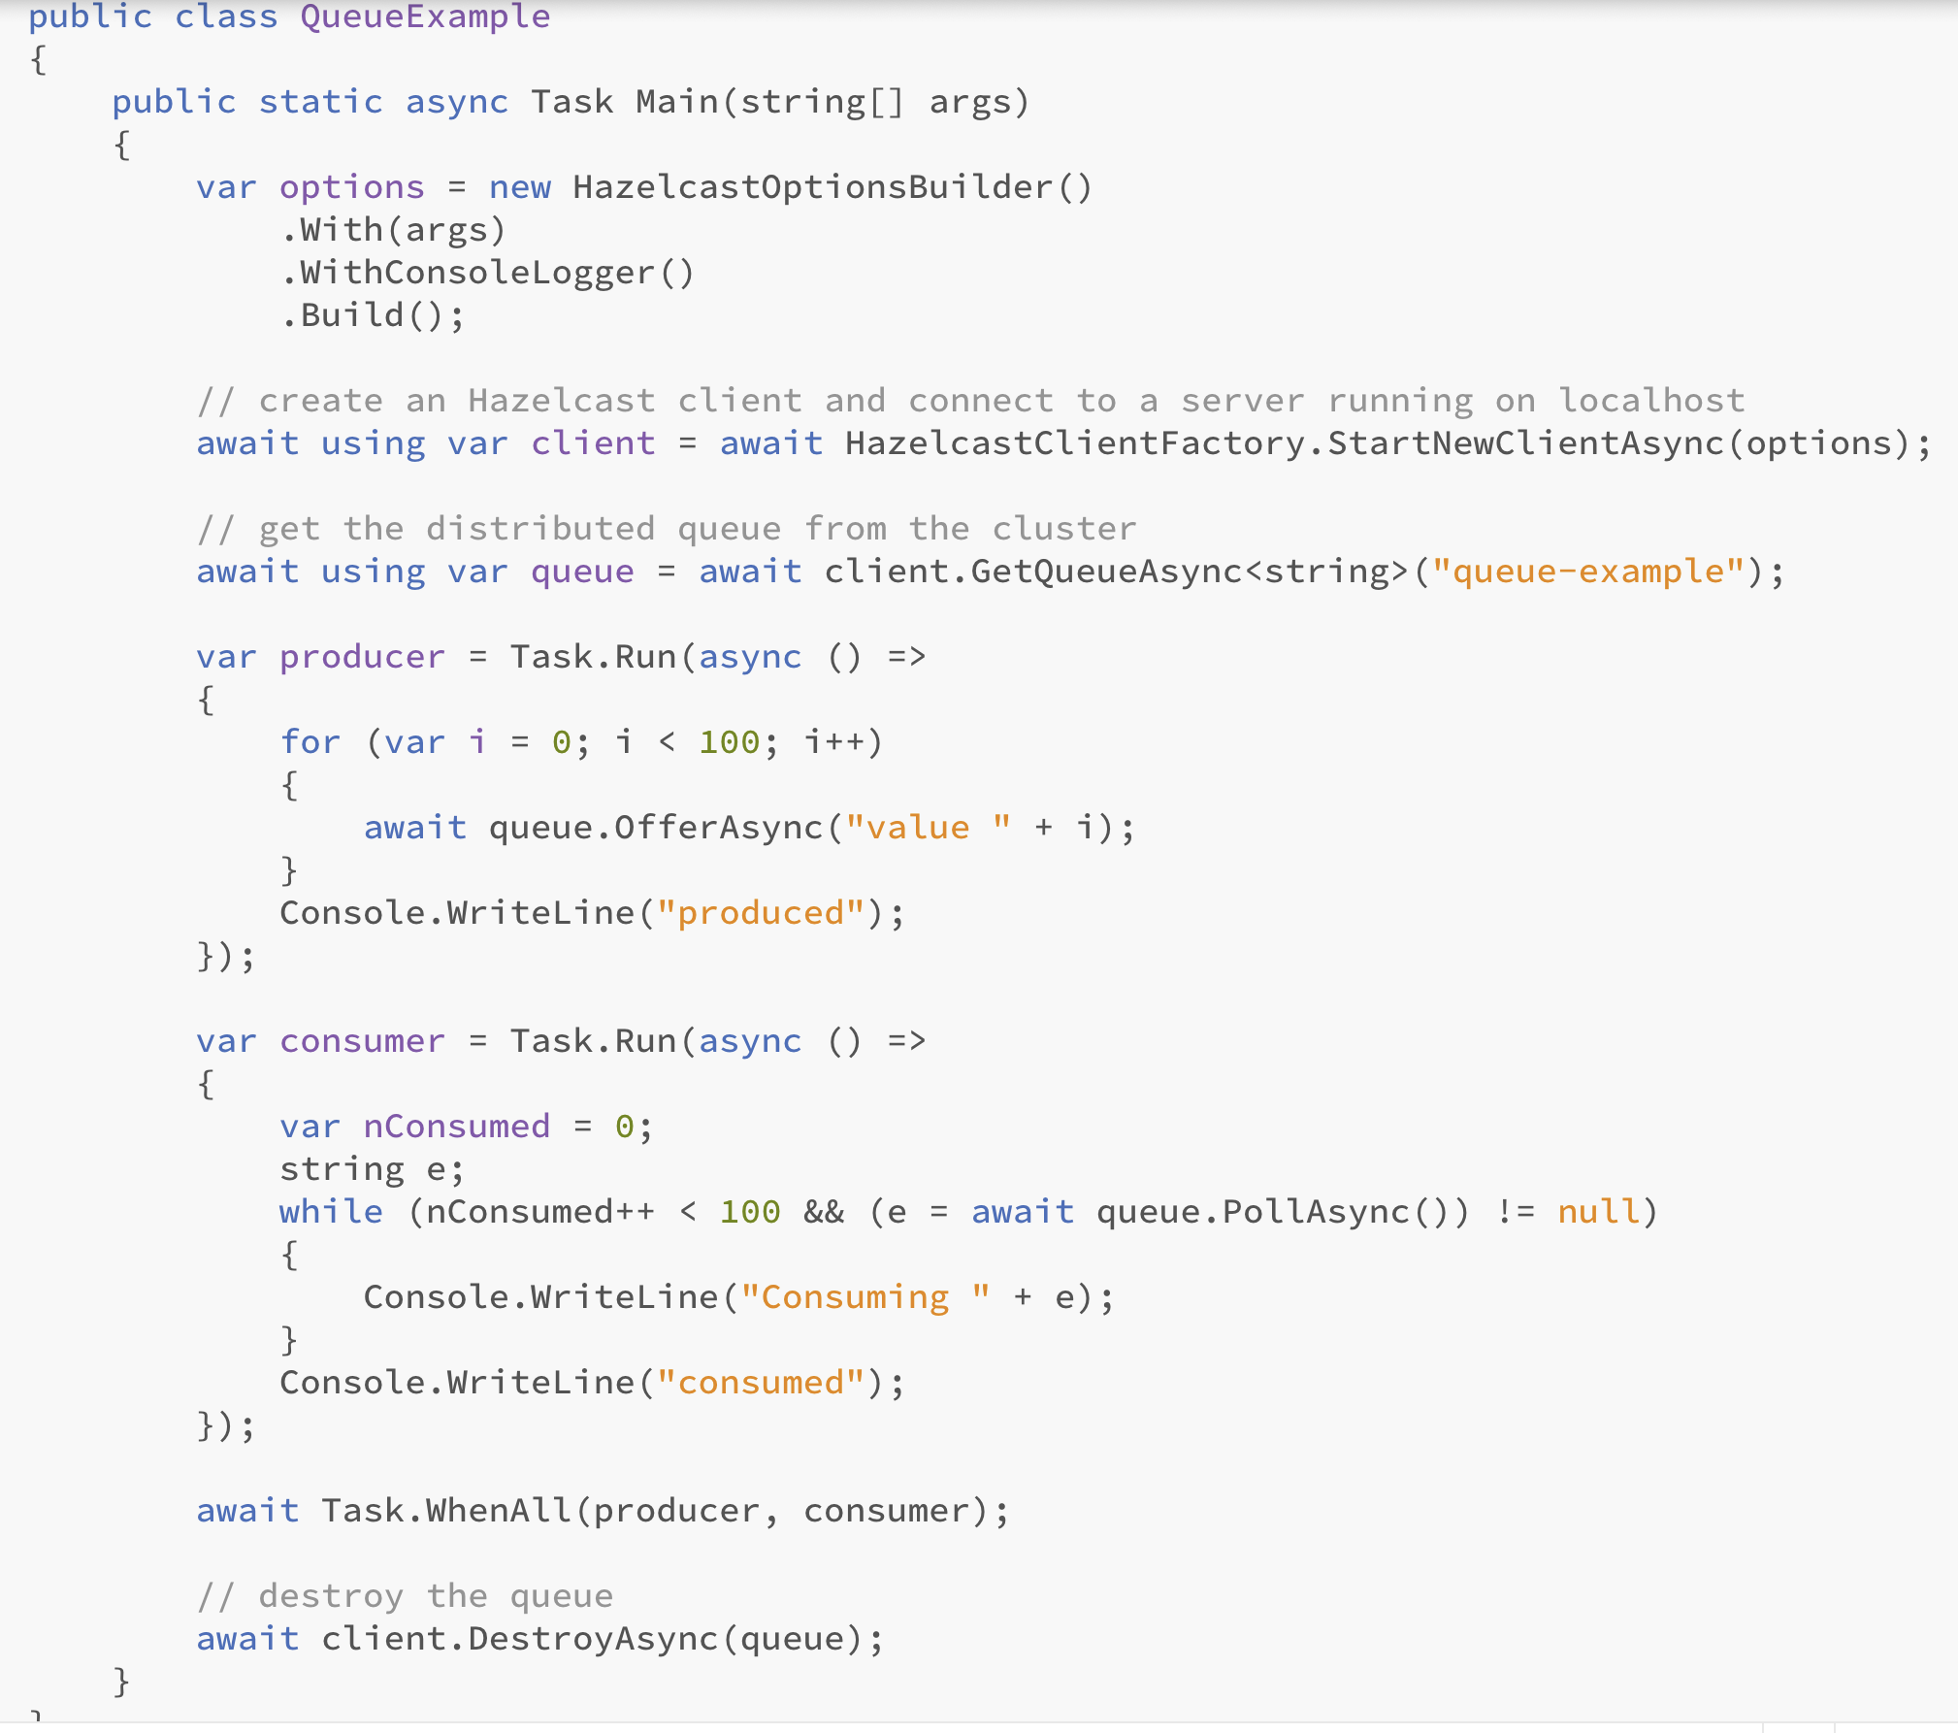
Queue / DistributedObjects

Slide 20
Distributed Objects Supported by the .NET Client
Map: A distributed map that stores key-value pairs. It works similarly to a .NET Dictionary<K,V>.
List: A distributed list implementation similar to a .NET List<T>.
Queue: A distributed queue implementation similar to a .NET Queue<T>.
Topic: A distribution mechanism for publishing messages sent to multiple subscribers.
Set: A distributed set implementation similar to a .NET HashSet<T>.
RingBuffer: A ring buffer stores content in a ring-like structure. A ring buffer has a fixed capacity, so it won’t grow to the extent that it could endanger the system’s stability.

Slide 21
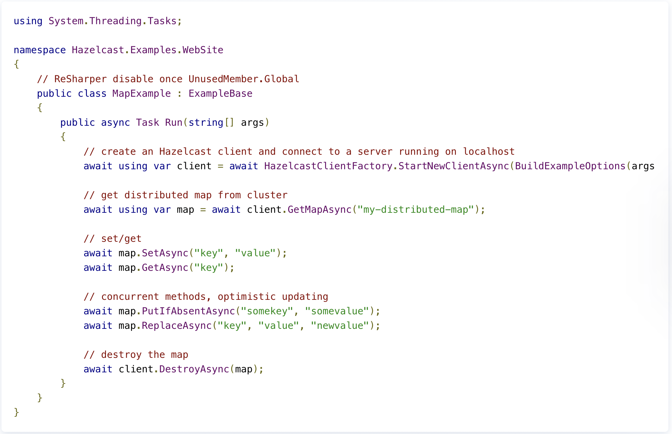
Map

Slide 22
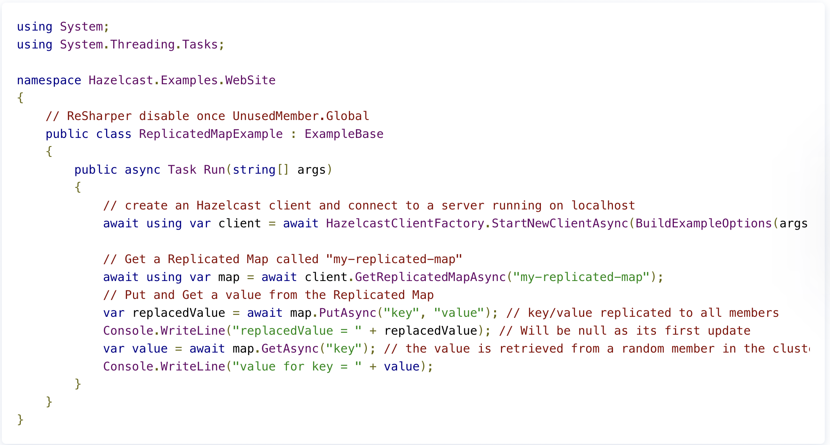
Replicated Map

Slide 23
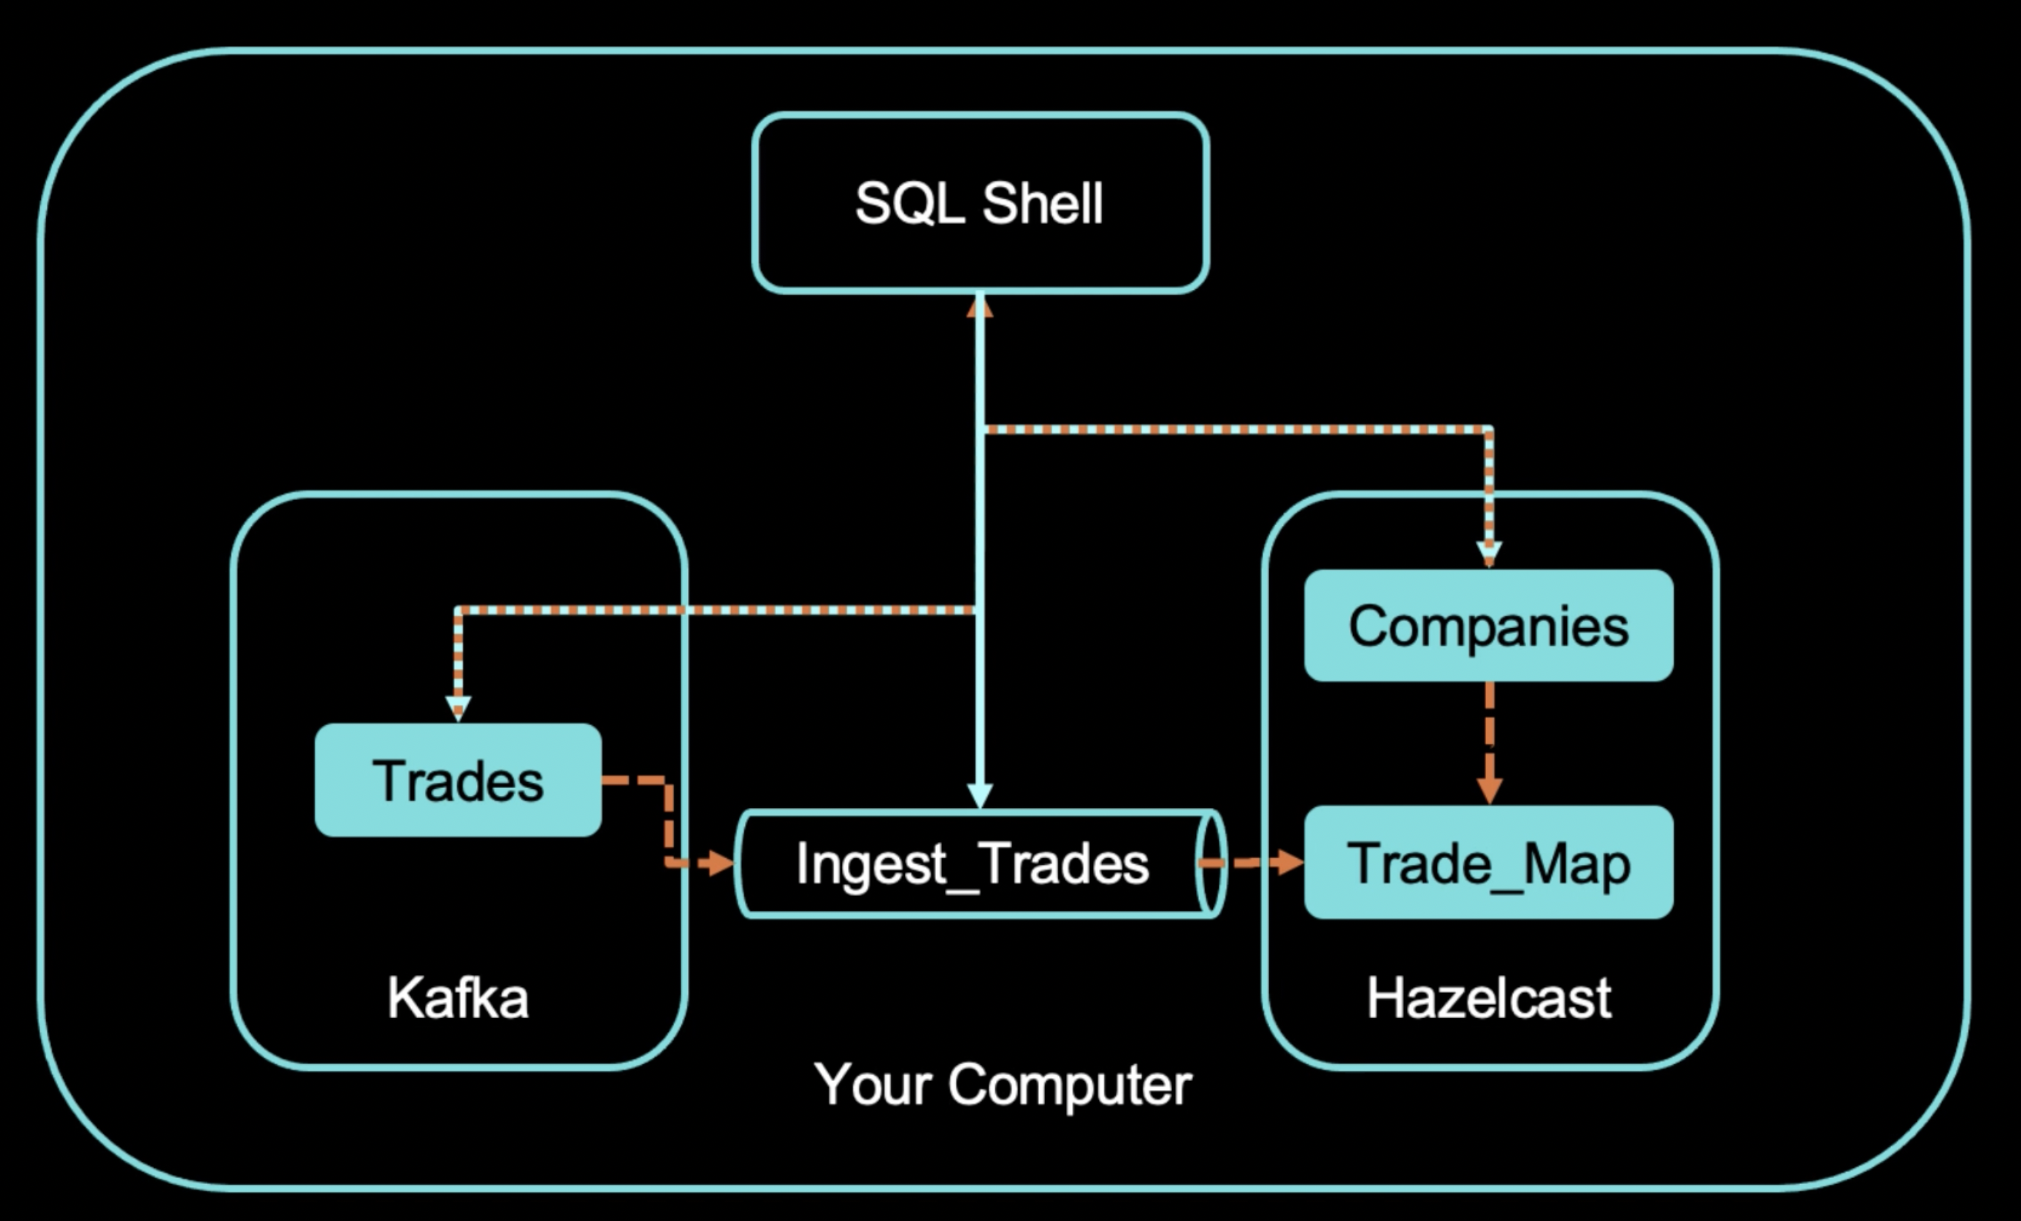
SQL Over Kafka

Slide 24
SQL Over Kafka
A Hazelcast cluster in client/server mode
A connection to the SQL shell
Set Up a Kafka Broker
Create a Mapping to Kafka
Run a Streaming Query on the Kafka Topic
Enrich the Data in the Kafka Messages
Ingest Query Results into a Hazelcast Map
Cancel the Job
Demo: http://54.247.48.102:7001/

Slide 25
Best Practices for .NET caching
Ingest data in real-time in any format
Use SQL to analyze data in real-time
Minimizing disk I/O by caching your data at scale
Use real-time data for multiple purposes
Focus on simplifying your code
Think if you need a zero downtime
Avoid the enemies (if you can)

Slide 26
Packaging the app
docker build -t zpqrtbnk/dotnetstockdemo -f Dockerfile .
docker tag zpqrtbnk/dotnetstockdemo:latest zpqrtbnk/dotnetstockdemo:1.0.0
docker login --username=zpqrtbnk
docker push zpqrtbnk/dotnetstockdemo:latest
docker logout

Slide 27
Enemies of Stream Processing
Network Hops
Storage I/O
Processor – “Context Switching”
Excessive or Unnecessary “Staged” Elements to Architecture
Data Enrichment Requiring Added Data Retrieval

Slide 28
Give It a Try or Learn More
https://hazelcast.com/get-started/
https://cloud.hazelcast.com/sign-up
https://hazelcast.com/clients/dotnet/
Learn More
Docs: https://docs.hazelcast.com/home/index.html
Training: https://training.hazelcast.com/
Blogs: https://hazelcast.com/blog/

Slide 29
Join the Hazelcast Developer Community
Slack: Join the Hazelcast Community on slack to chat with users and developers of Hazelcast.
Local events: Speak at or meet the Hazelcast Local community
Twitch live streams: Live sessions, interviews, office hours
Community Blog: Write about your experience or read how other developers use Hazelcast
Hazelcast Heroes: Become a Hazelcast Hero (or even a Hazelcast employee)
Email: developer-relations@hazelcast.com

Slide 30
Hazelcast is Hiring!
Solutions Architect - Remote
Product Manager
Senior Product Manager
Software Engineer
Senior Software Engineer
Senior Site Reliability Engineer
Check: https://hazelcast.com/company/careers/

Slide 31
Scan QR Code to Win $100 Gift Voucher

Slide 32
Thank you! Q&A
Fawaz Ghali – Developer Advocate
@fawazghali

